Slide 1


Level-Up Power BI Dashboard Storytelling with DataViz Tools
Ioannis Philippides
Sr. Marketing Consultant - Power BI

Slide 2




Ioannis
Philippides
Sr. Marketing Consultant
Data Analyst across various industries including consulting, marketing, insurance, sales, and product. Several years of experience with Power BI.
Currently, I am working at TD Reply, a marketing consulting company in Berlin, DE.
@ioannisphilipp2
linkedin.com/in/ioannisphilippides/
github.com/IoannisPhilippides

Slide 3
Well-designed Dashboards by Stephen Few
Exceptionally Organized
Customized to the user objectives
Condensed
Concise and clear Message Communication
Notes:
Let’s start with what is considered a well-designed dashboard. According to Stephen Few, is the dashboard that is exceptionally organized and meets the end users' expectations. It provides a lot of insights without being noisy and delivers a concise and clear message.

Slide 4
Dashboard Creation Journey
Visual Display
User Oriented
Context
Storytelling
Data
Text
Size
Gestalt
Structure
Scope
Tables
Color
Accessibility
Framework
Audience
Charts
Position
Aesthetics
Notes:
Let’s walk together through the dashboard creation Journey and its 4 main pillars. Context, Visual Display, User Focus, and Storytelling.

Slide 5

Dashboard Creation Journey
Visual Display
User Oriented
Context
Storytelling
What is the domain?
Date granularity
Update Frequency
Data
Size
Gestalt
Data
Text
Structure
Scope
Tables
Color
Accessibility
Framework
Audience
Charts
Position
Aesthetics
Notes:
Regarding Context, it is mainly all about data and good quality data. We should get to know and keep in mind, what is the domain, what is the available date granularity, and what would be the desirable update frequency e.g., weekly, monthly, or real-time. We should keep in mind the Business questions to be answered based on the dashboard and decide which metrics would help in that direction. We can make a KPI mapping for that and we should keep in mind how the dashboard is meant to be used. Maybe during a weekly meeting to track performance or on a monthly manager meeting to make strategic decisions. What are the objectives? One tip from my side here would be: use pen & paper or post-it to design the dashboard. Just to avoid the hustle of using software and sabotage creativity. We should also have in mind the roles of the users. Are they going to have a strategic perspective on the dashboard, analytical, or maybe operational?

Slide 6

Dashboard Creation Journey
Visual Display
User Oriented
Context
Storytelling
Business Questions
Metrics to help decision making
Use KPI mapping (e.g., Castordoc)
How is the dashboard used?
User’s Objectives
Data
Text
Size
Gestalt
Structure
Scope
Color
Accessibility
Scope
Tables
Framework
Tip: Design the dashboard with pen & paper or post-it
Audience
Charts
Position
Aesthetics

Slide 7

Dashboard Creation Journey
Visual Display
User Oriented
Context
Storytelling
What are their roles/personas?
Strategical
Analytical
Operational
What information do they need to be successful?
Data
Text
Size
Gestalt
Structure
Scope
Tables
Color
Accessibility
Framework
Audience
Position
Aesthetics
Audience
Charts

Slide 8
Dashboard Creation Journey
Visual Display
User Oriented
Context
Storytelling
When it comes to typography in Power BI:
Use collective learning, stick to Arial, Times New Roman, Segoe
Select a font size for each case (e.g., title, content) and be consistent
Data
Text
Size
Gestalt
Text
Structure
Scope
Tables
Color
Accessibility
Framework
Tip: Use contrast to create hierarchy and not grey text on colored backgrounds
Audience
Charts
Position
Aesthetics

Slide 9
Dashboard Creation Journey
Visual Display
User Oriented
Context
Storytelling
Use tables in Power BI, when:
The stakeholder needs high data granularity
Export of data after filtering is needed
Data
Text
Size
Gestalt
Structure
Tip: right-align numbers
Scope
Tables
Color
Accessibility
Framework
Audience
Charts
Position
Aesthetics

Slide 10
Dashboard Creation Journey
Visual Display
User Oriented
Context
Storytelling
In Power BI you will mostly use the visuals:
Bar Charts
Line Charts
Cards
Maps
Waterfall Charts
Data
Text
Size
Gestalt
Structure
Scope
Tables
Color
Accessibility
Framework
Audience
Charts
Position
Aesthetics
Charts

Slide 11
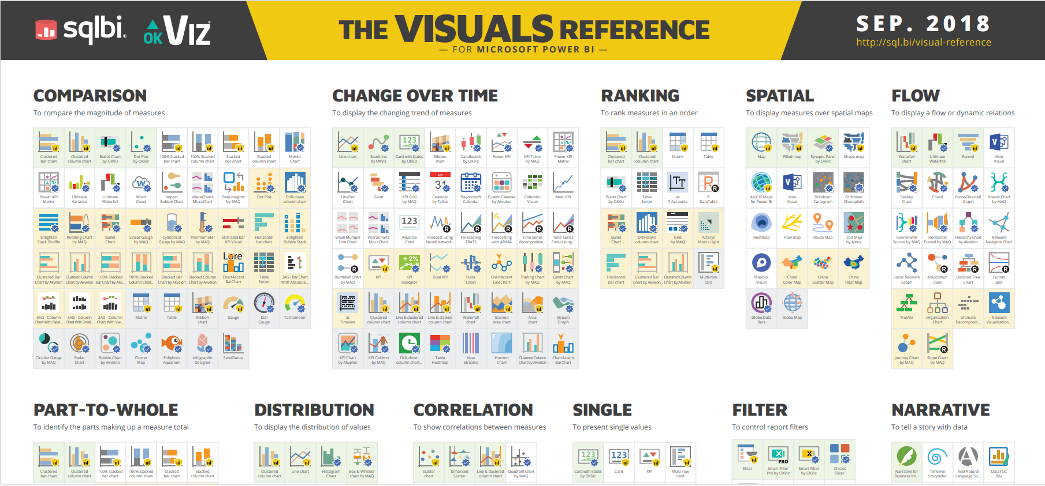
Dashboard Creation Journey
Visual Display
User Oriented
Context
Storytelling
If not sure which visual to use, consult the Visuals Reference from SQLBI
Data
Text
Size
Gestalt
Structure
Scope
Tables
Color
Accessibility
Framework
Audience
Charts
Position
Aesthetics

Slide 12
Dashboard Creation Journey
Visual Display
User Oriented
Context
Storytelling
Data-Ink Ratio
By Edward Tufte
The proportion of the visualization that can be erased without losing information
The higher the ratio the better
Data
Text
Size
Gestalt
Structure
Scope
Tables
Color
Accessibility
Framework
Audience
Charts
Position
Aesthetics

Slide 13
Dashboard Creation Journey
Visual Display
User Oriented
Context
Storytelling
Don’t use 3D visuals
Avoid pie, gauge, radar, and area charts
Use zero as your chart baseline
No scrolling - Place all charts on a single screen
Use suitable proportions
Data
Text
Size
Gestalt
Structure
Scope
Tables
Color
Accessibility
Framework
Audience
Charts
Position
Aesthetics

Slide 14
Dashboard Creation Journey
Visual Display
User Oriented
Context
Storytelling
Use font and visual size to direct the user’s attention
Bigger size makes items more prominent
Be mindful, overusing it will add noise to the dashboard
Size
Gestalt
Data
Text
Size
Structure
Scope
Tables
Color
Accessibility
Framework
Audience
Charts
Position
Aesthetics

Slide 15
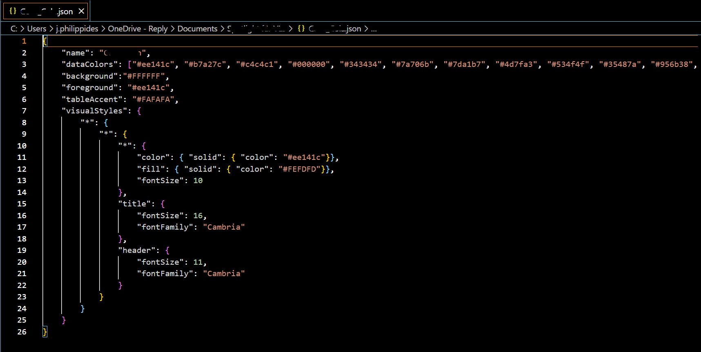
Dashboard Creation Journey
Visual Display
User Oriented
Context
Storytelling
Standardize your colors by using a palette
Use colors consistently (e.g., Categories)
Use tools such as Coolors.co, Adobe color wheel or HEX pickers
Data
Text
Size
Gestalt
Structure
In Power BI use themes to standardize the colors. Prefer to import your custom ones
Scope
Tables
Color
Accessibility
Framework
Audience
Charts
Position
Aesthetics

Slide 16
Dashboard Creation Journey
Visual Display
User Oriented
Context
Storytelling
Use the Z-shape structure
Position what you want to emphasize in a central place
Data
Text
Size
Gestalt
Structure
Start with high-level information on top and continue with more granular
Tip: avoid diagonal structure
Scope
Tables
Color
Accessibility
Framework
Charts
Position
Aesthetics
Audience
Position

Slide 17
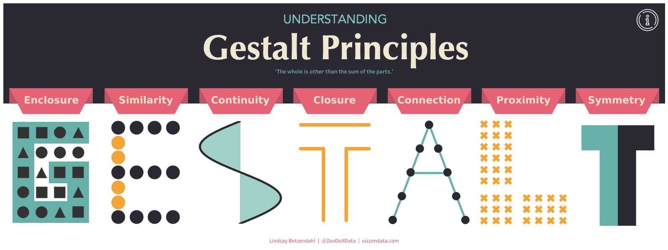
Dashboard Creation Journey
Visual Display
User Oriented
Context
Storytelling
Size
Gestalt
Data
Text
Gestalt
Structure
Scope
Tables
Color
Accessibility
Framework
Audience
Charts
Position
Aesthetics

Slide 18
Dashboard Creation Journey
Visual Display
User Oriented
Context
Storytelling
Color blindness affects 8% of men and 0,5% of women
Test your dashboard using color-blindness.com simulator
Data
Text
Size
Gestalt
Structure
Tip: Use contrast accordingly
Scope
Color
Accessibility
Tables
Accessibility
Framework
Audience
Charts
Position
Aesthetics

Slide 19
Dashboard Creation Journey
Visual Display
User Oriented
Context
Storytelling
Data
“ Every element we put on a page or screen puts a cognitive burden on our audience”
Cole Nussbaumer Knaflic
Size
Gestalt
Text
Structure
Scope
Tables
Color
Accessibility
Framework
Position
Aesthetics
Audience
Charts
Aesthetics

Slide 20

Dashboard Creation Journey
Visual Display
User Oriented
Context
Storytelling
Avoid clutter. White space should be removed, not added
Use margins and padding
Use a 12-column grid
Systematize fonts, dimensions, and colors and use them in a consistent way
Use icons as cues for your audience
Data
Text
Size
Gestalt
Structure
Scope
Tables
Color
Accessibility
Framework
Tip: Find icons in Google Fonts or fontawesome.com
Audience
Charts
Position
Aesthetics

Slide 21
Dashboard Creation Journey
Visual Display
User Oriented
Context
Storytelling
Keep in mind a standard story sequence
Beginning – Middle - End
Data
Text
Size
Gestalt
Structure
Structure
“ .. Crucial to our evolution – more so than opposable thumbs. Opposable thumbs let us hang on; story told us what to hang on to”
Understanding the World – Sandra Rendgen
Scope
Tables
Color
Accessibility
Framework
Audience
Charts
Position
Aesthetics

Slide 22
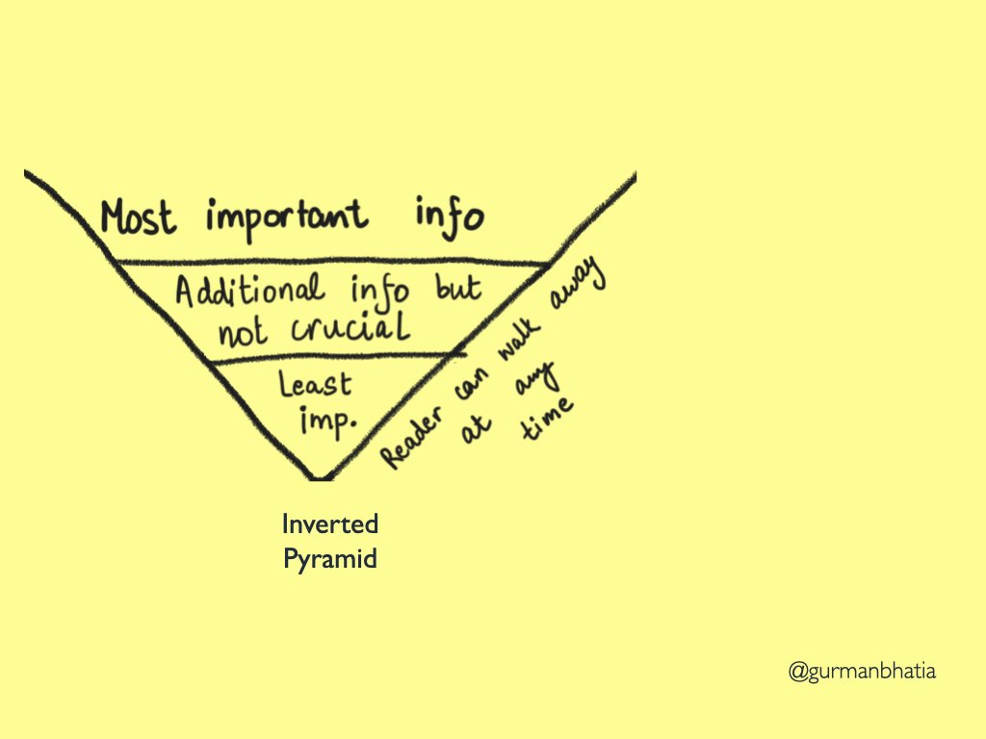
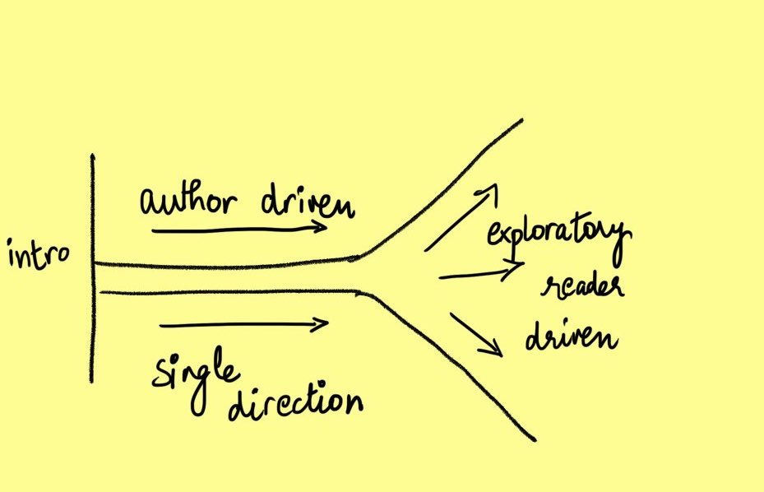
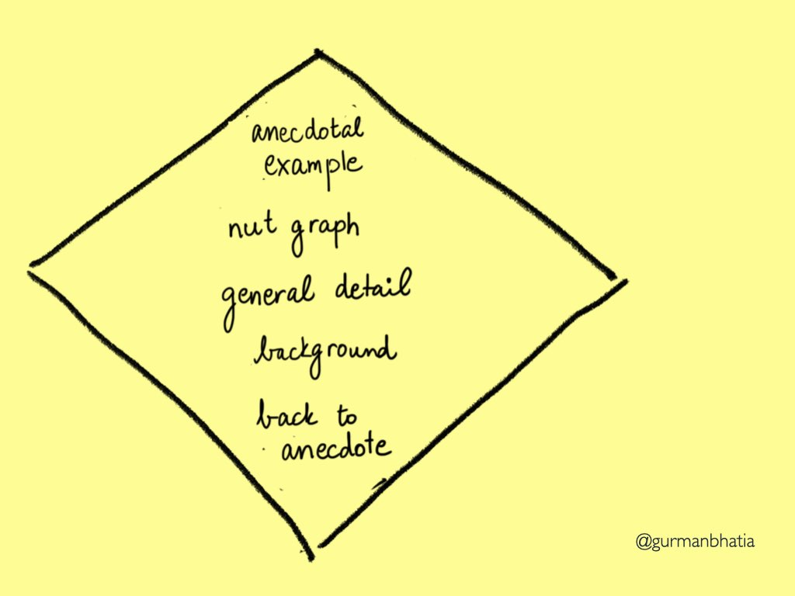
Dashboard Creation Journey
Visual Display
User Oriented
Context
Storytelling
Inverted Pyramid
Martini Glass
Hourglass
Diamond
Data
Text
Size
Gestalt
Structure
Scope
Tables
Color
Accessibility
Framework
Framework
Audience
Charts
Position
Aesthetics
Image credits: Gurman Bhatia

Slide 23
Dashboard Creation Journey
Visual Display
User Oriented
Context
Storytelling
Data
Text
Size
Gestalt
Structure
Scope
Tables
Color
Accessibility
Framework
Audience
Charts
Position
Aesthetics

Slide 24
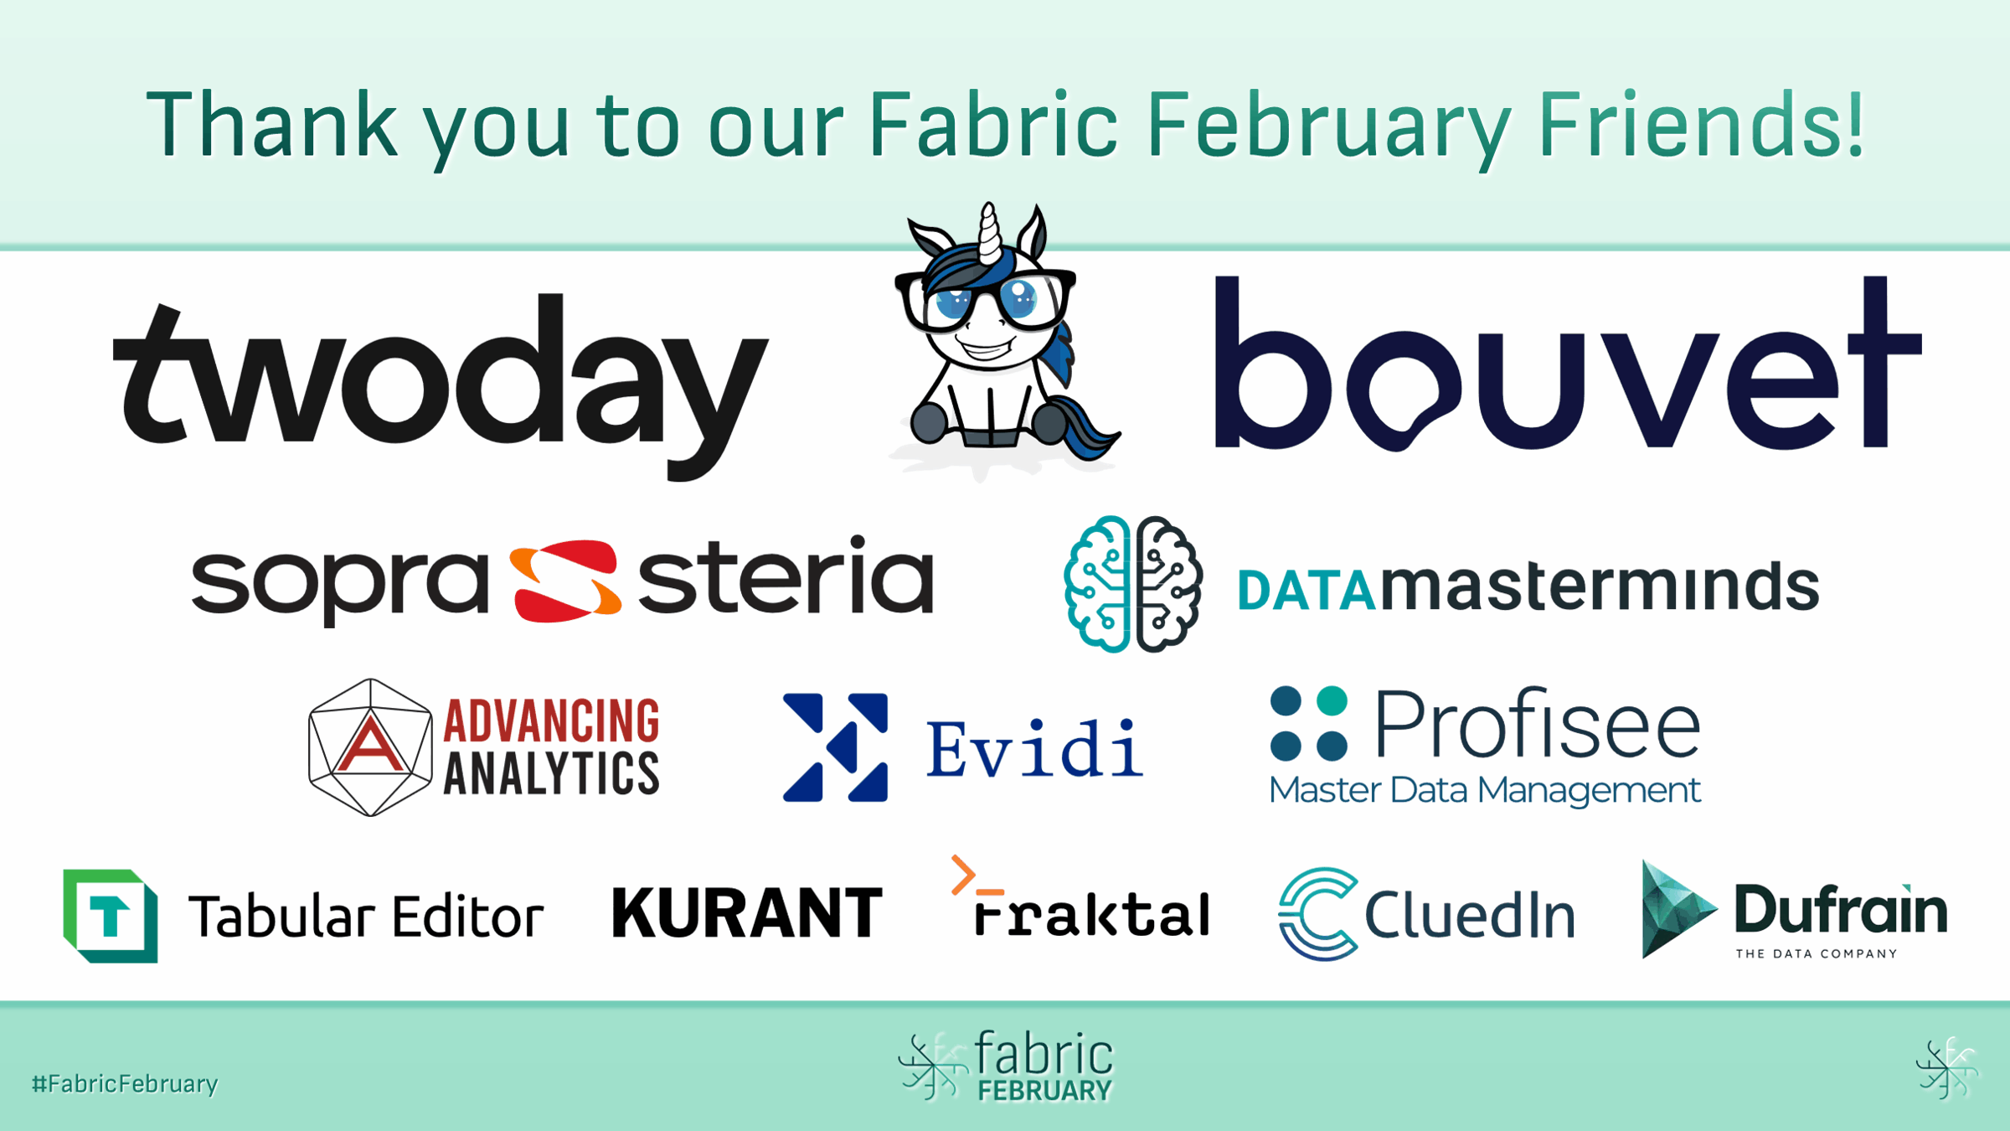

Slide 25
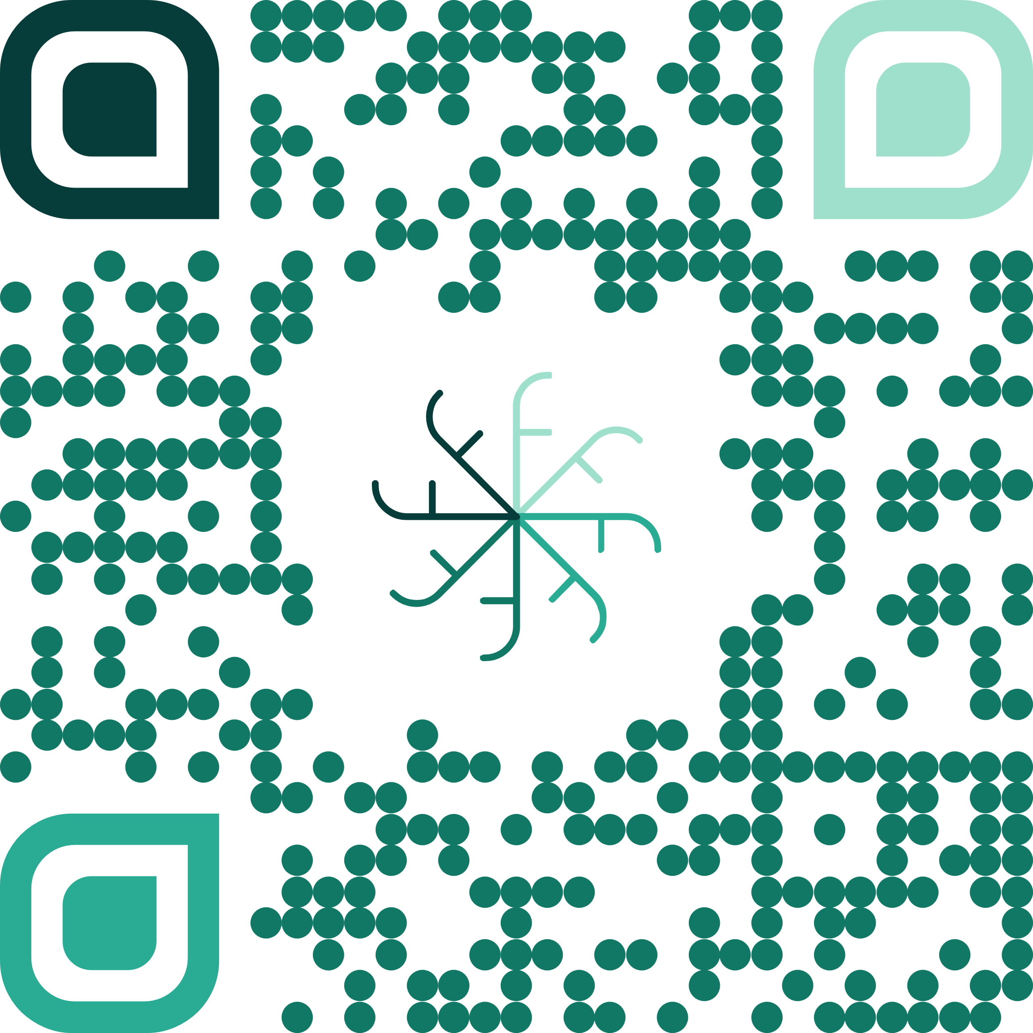
Thank you!

Slide 26
Dashboard Creation Journey
Visual Display
User Oriented
Context
Storytelling
Data
Text
Size
Gestalt
Structure
Scope
Tables
Color
Accessibility
Framework
Audience
Charts
Position
Aesthetics
Scope
Data
Data
What is the domain?
Date granularity
Update Frequency
What is the domain?
Date granularity
Update Frequency

