Slide 1
Welcome to Fabric February!

Slide 2
Fabric February Sponsors

Slide 3
Leveraging Semantic Link in Microsoft Fabric for Powerful Machine Learning Workflows
August Asheim Birkeland, Erlend Øien

Slide 4
Speakers
August Asheim Birkeland
Erlend Øien
Data Engineer & Data Scientist
Data Engineer & Data Scientist
Evidi
Evidi
/augustasheimbirkeland
/eoeien
Notes:
"We will start by talking about the data science process within Microsoft Fabric. Following we will explain what semantic link is, and give a Demo where we use it. Next we will cover each step of the data science process, and show you three demo cases for a given problem definiton. Then we will wrap it up and give you some key takeaways.

Slide 5
Data Science in Microsoft Fabric

Slide 6
Feature comparison to other AI and ML-platforms
 | Fabric Data Science Experience | Azure Machine Learning | Databricks
Compute | Serverless, configurable | Managed | Serverless, Managed
Notes:
Compared against two established ML platforms of today
Other two primarily PaaS, fabric is created as a SaaS. Since Fabric is a SaaS it requires less configuration/management than the other two and facilitatates for rapid development.
Other two primarily PaaS, fabric is created as a SaaS. Hence Fabric in general requires less configuration/management than the other two and facilitatates for rapid development.
Hence Fabric in general requires less configuration/management than the other two, and can provide quick value.
We see that most of the features are covered by Fabric, However
Given that Fabric still can be considered a fresh solution its impressive that it already is comparable with these two.
So here we have created a comparison of Fabric against two of the most established Machine Learning Platforms as of today, Azure Machine Learning and Databricks.
While the two other platforms are primarily considered to be PaaS solutions, Microsoft Fabric is a SaaS. Furthermore, its architecture makes it extremely well-suited to integrate with data stored in a Fabric Data Lake/Data Warehouse both for training and inference use cases.
We see that most of the features are covered in Fabric. As of today, it only supports batch processing; however, if you use MLflow, it is possible to export the model to, for instance, Azure Machine Learning and make it accessible as an endpoint there. Regarding GPU support, it is also possible to train PyTorch models on GPU in Azure ML, make them available as an endpoint, and call this endpoint from a Fabric notebook.
Given that Fabric can still be considered a fresh solution, it is impressive that it already is comparable with these more mature solutions.
So here we have created a comparison of Fabric against two of the most established Machine Learning Platforms as of today, Azure Machine Learning and Databricks
While the two other platforms are primarily considered to be Paas solutions, Microsoft Fabric is a Saas. Hence, fabric focuses on being easy to use and legge til rette for hurtig utvikling. Generally it requires less configuration/management of compute and data resources than Azure ML. Furthermore, its architecture makes it extremely well suited to integrate with data stored in a Fabric Data Lake/Data Warehouse both for training and inference use cases
We se that most of the features are covered in Fabric. As of today it only supports batch processing, however if you use mlflow it is possible to export the model to for instance azure machine learning and make it accessible as an endpoint there. Regarding GPU support, it is also possible to train Pytorch models on GPU in Azure ML, make them available as an endpoint, an call this endpoint from a fabric notebook.
Given that fabric still can be considered a fresh solution, it is impressive that it already is sammenlignbar with these more mature solutions.
Poeng få frem: allerede så tilbyr fabric mye av det samme som de mer modne plattform, i tillegg til at det er en helhetlig plattform, ikke bare en paas som Azure Machine Learning er. Fabric tilbyr mye mer i tillegg til dette.
Fabric har kanskje litt mindre, men det viktige er at Fabric er en SaaS og vi må huske på det positive med den hurtige utviklignen som fabric legger til rette for.
Det er en veldig brukervennlig plattform, bruker lite tid på config ting som man gjerne bruker tid på med en Paas løsning.
Konklusjon: den er såpass fersk, men den er allerede sammenlignbar med ML plattformer.
Data som er lagret i Fabric kan du bruke både i Azure Machine Learning og i Databrics.
COMPUTE
Fabric: Serverless og configurable. Serverless simplifies in that you do not have to manage the underlying infrastructure (servers, clusters, vms), you also only pay for the resources you use. The configurable points stem from the fact that you can configure starter pools and create custom pools
LOW CODE ML
Fabric and Databrics do not have it. Eg here you have to at least write one line of code. However with Azure Machine Learning (and VertexAI and Sagemaker) you can upload a dataset and then just check boxes and choose a problem type.
BUILT IN ExAI
Fabric:https://microsoft.github.io/SynapseML/docs/Explore%20Algorithms/Responsible%20AI/Interpreting%20Model%20Predictions/
Databrics:https://community.databricks.com/t5/machine-learning/responsible-ai-on-databricks/td-p/31315
Azure machine learning: Model interpretability - Azure Machine Learning | Microsoft Learn
Databricks:
BUILT-IN DEPLOYMENT TOOLS: Quickly deploy on Databricks via Apache Spark UDF for a local machine, or several other production environments such as Microsoft Azure ML, Amazon SageMaker, and building Docker Images for Deployment. Er apache spark UDF funksjonaliteten grunnen til at det er endpoint mulighet her?

Slide 7
Feature comparison to other AI and ML-platforms
 | Fabric Data Science Experience | Azure Machine Learning | Databricks
Compute | Serverless, configurable | Managed | Serverless, Managed
Model versioning | Yes | Yes | Yes
Model Serving | Batch and Endpoint* | Batch and Endpoint | Batch and Endpoint
Experiment Tracking | Yes | Yes | Yes
No/Low-code ML | Yes | Yes | Yes
AutoML | Yes | Yes | Yes
GPU-support | No | Yes | Yes
LLM-capabilities | Yes | Yes | Yes
Feature store | No | Yes | Yes
Built-in ExAI | Yes | Yes | Yes
Notes:
Compared against two established ML platforms of today
Other two primarily PaaS, fabric is created as a SaaS. Hence Fabric in general requires less configuration/management than the other two and facilitatates for rapid development.
Hence Fabric in general requires less configuration/management than the other two, and can provide quick value.
We see that most of the features are covered by Fabric, However
Given that Fabric still can be considered a fresh solution its impressive that it already is comparable with these two.
"Microsoft Fabric customers have diverse business needs, data, and AI use cases. Previously, customers that needed to connect to data in OneLake from AzureML had to s to inject data into their AI solutions. Now, AzureML provides an out-of-the-box data connector in the form of “OneLake datastore” to help customers directly access data from OneLake"
So here we have created a comparison of Fabric against two of the most established Machine Learning Platforms as of today, Azure Machine Learning and Databricks.
While the two other platforms are primarily considered to be PaaS solutions, Microsoft Fabric is a SaaS. Furthermore, its architecture makes it extremely well-suited to integrate with data stored in a Fabric Data Lake/Data Warehouse both for training and inference use cases.
We see that most of the features are covered in Fabric. As of today, it only supports batch processing; however, if you use MLflow, it is possible to export the model to, for instance, Azure Machine Learning and make it accessible as an endpoint there. Regarding GPU support, it is also possible to train PyTorch models on GPU in Azure ML, make them available as an endpoint, and call this endpoint from a Fabric notebook.
Given that Fabric can still be considered a fresh solution, it is impressive that it already is comparable with these more mature solutions.
So here we have created a comparison of Fabric against two of the most established Machine Learning Platforms as of today, Azure Machine Learning and Databricks
While the two other platforms are primarily considered to be Paas solutions, Microsoft Fabric is a Saas. Hence, fabric focuses on being easy to use and legge til rette for hurtig utvikling. Generally it requires less configuration/management of compute and data resources than Azure ML. Furthermore, its architecture makes it extremely well suited to integrate with data stored in a Fabric Data Lake/Data Warehouse both for training and inference use cases
We se that most of the features are covered in Fabric. As of today it only supports batch processing, however if you use mlflow it is possible to export the model to for instance azure machine learning and make it accessible as an endpoint there. Regarding GPU support, it is also possible to train Pytorch models on GPU in Azure ML, make them available as an endpoint, an call this endpoint from a fabric notebook.
Given that fabric still can be considered a fresh solution, it is impressive that it already is sammenlignbar with these more mature solutions.
Poeng få frem: allerede så tilbyr fabric mye av det samme som de mer modne plattform, i tillegg til at det er en helhetlig plattform, ikke bare en paas som Azure Machine Learning er. Fabric tilbyr mye mer i tillegg til dette.
Fabric har kanskje litt mindre, men det viktige er at Fabric er en SaaS og vi må huske på det positive med den hurtige utviklignen som fabric legger til rette for.
Det er en veldig brukervennlig plattform, bruker lite tid på config ting som man gjerne bruker tid på med en Paas løsning.
Konklusjon: den er såpass fersk, men den er allerede sammenlignbar med ML plattformer.
Data som er lagret i Fabric kan du bruke både i Azure Machine Learning og i Databrics.
COMPUTE
Fabric: Serverless og configurable. Serverless simplifies in that you do not have to manage the underlying infrastructure (servers, clusters, vms), you also only pay for the resources you use. The configurable points stem from the fact that you can configure starter pools and create custom pools
LOW CODE ML
Fabric and Databrics do not have it. Eg here you have to at least write one line of code. However with Azure Machine Learning (and VertexAI and Sagemaker) you can upload a dataset and then just check boxes and choose a problem type.
BUILT IN ExAI
Fabric:https://microsoft.github.io/SynapseML/docs/Explore%20Algorithms/Responsible%20AI/Interpreting%20Model%20Predictions/
Databrics:https://community.databricks.com/t5/machine-learning/responsible-ai-on-databricks/td-p/31315
Azure machine learning: Model interpretability - Azure Machine Learning | Microsoft Learn
Databricks:
BUILT-IN DEPLOYMENT TOOLS: Quickly deploy on Databricks via Apache Spark UDF for a local machine, or several other production environments such as Microsoft Azure ML, Amazon SageMaker, and building Docker Images for Deployment. Er apache spark UDF funksjonaliteten grunnen til at det er endpoint mulighet her?

Slide 8
Feature comparison to other AI and ML-platforms
 | Fabric Data Science Experience | Azure Machine Learning | Databricks
Compute | Serverless, configurable | Managed | Serverless, Managed
Model versioning | Yes | Yes | Yes
Model Serving | Batch and Endpoint* | Batch and Endpoint | Batch and Endpoint
Experiment Tracking | Yes | Yes | Yes
No/Low-code ML | Yes | Yes | Yes
AutoML | Yes | Yes | Yes
GPU-support | No | Yes | Yes
LLM-capabilities | Yes | Yes | Yes
Feature store | No | Yes | Yes
Built-in ExAI | Yes | Yes | Yes
“Newcomer”, but Comparable AI Offerings
Notes:
Compared against two established ML platforms of today
Other two primarily PaaS, fabric is created as a SaaS. Hence Fabric in general requires less configuration/management than the other two and facilitatates for rapid development.
Hence Fabric in general requires less configuration/management than the other two, and can provide quick value.
We see that most of the features are covered by Fabric, However
Given that Fabric still can be considered a fresh solution its impressive that it already is comparable with these two.
"Microsoft Fabric customers have diverse business needs, data, and AI use cases. Previously, customers that needed to connect to data in OneLake from AzureML had to s to inject data into their AI solutions. Now, AzureML provides an out-of-the-box data connector in the form of “OneLake datastore” to help customers directly access data from OneLake"
So here we have created a comparison of Fabric against two of the most established Machine Learning Platforms as of today, Azure Machine Learning and Databricks.
While the two other platforms are primarily considered to be PaaS solutions, Microsoft Fabric is a SaaS. Furthermore, its architecture makes it extremely well-suited to integrate with data stored in a Fabric Data Lake/Data Warehouse both for training and inference use cases.
We see that most of the features are covered in Fabric. As of today, it only supports batch processing; however, if you use MLflow, it is possible to export the model to, for instance, Azure Machine Learning and make it accessible as an endpoint there. Regarding GPU support, it is also possible to train PyTorch models on GPU in Azure ML, make them available as an endpoint, and call this endpoint from a Fabric notebook.
Given that Fabric can still be considered a fresh solution, it is impressive that it already is comparable with these more mature solutions.
So here we have created a comparison of Fabric against two of the most established Machine Learning Platforms as of today, Azure Machine Learning and Databricks
While the two other platforms are primarily considered to be Paas solutions, Microsoft Fabric is a Saas. Hence, fabric focuses on being easy to use and legge til rette for hurtig utvikling. Generally it requires less configuration/management of compute and data resources than Azure ML. Furthermore, its architecture makes it extremely well suited to integrate with data stored in a Fabric Data Lake/Data Warehouse both for training and inference use cases
We se that most of the features are covered in Fabric. As of today it only supports batch processing, however if you use mlflow it is possible to export the model to for instance azure machine learning and make it accessible as an endpoint there. Regarding GPU support, it is also possible to train Pytorch models on GPU in Azure ML, make them available as an endpoint, an call this endpoint from a fabric notebook.
Given that fabric still can be considered a fresh solution, it is impressive that it already is sammenlignbar with these more mature solutions.
Poeng få frem: allerede så tilbyr fabric mye av det samme som de mer modne plattform, i tillegg til at det er en helhetlig plattform, ikke bare en paas som Azure Machine Learning er. Fabric tilbyr mye mer i tillegg til dette.
Fabric har kanskje litt mindre, men det viktige er at Fabric er en SaaS og vi må huske på det positive med den hurtige utviklignen som fabric legger til rette for.
Det er en veldig brukervennlig plattform, bruker lite tid på config ting som man gjerne bruker tid på med en Paas løsning.
Konklusjon: den er såpass fersk, men den er allerede sammenlignbar med ML plattformer.
Data som er lagret i Fabric kan du bruke både i Azure Machine Learning og i Databrics.
COMPUTE
Fabric: Serverless og configurable. Serverless simplifies in that you do not have to manage the underlying infrastructure (servers, clusters, vms), you also only pay for the resources you use. The configurable points stem from the fact that you can configure starter pools and create custom pools
LOW CODE ML
Fabric and Databrics do not have it. Eg here you have to at least write one line of code. However with Azure Machine Learning (and VertexAI and Sagemaker) you can upload a dataset and then just check boxes and choose a problem type.
BUILT IN ExAI
Fabric:https://microsoft.github.io/SynapseML/docs/Explore%20Algorithms/Responsible%20AI/Interpreting%20Model%20Predictions/
Databrics:https://community.databricks.com/t5/machine-learning/responsible-ai-on-databricks/td-p/31315
Azure machine learning: Model interpretability - Azure Machine Learning | Microsoft Learn
Databricks:
BUILT-IN DEPLOYMENT TOOLS: Quickly deploy on Databricks via Apache Spark UDF for a local machine, or several other production environments such as Microsoft Azure ML, Amazon SageMaker, and building Docker Images for Deployment. Er apache spark UDF funksjonaliteten grunnen til at det er endpoint mulighet her?

Slide 9
The Data Science Process
Problem formulation / Ideation
Experiment & Model
Insights
Prepare
Model
Data Discovery & Pre-Processing
Enrich & Operationalise
Explore
Evaluate

Slide 10
How Fabric Simplifies Data Science
Low-code data transformations with Data Wrangler
Copilot for Data Science
Simplified environment experience
Semantic Link for accessing existing Semantic Models created in Power BI

Slide 11
Semantic Link
What is it really?

Slide 12
What is Semantic Link and why is it useful?
Semantic Link
For simplifying Data exploration – Data is already cleaned and modelled!
Power BI
For reusing business logic and KPIs
Apache
Spark / Python
For End-to-end data validation – Validate your Business logic too!
Direct
Lake
Enable ML capabilities without extensive ML expertise
OneLake

Slide 13
What is Semantic Link

Slide 14
Isn’t Machine Learning available in Power BI already?
Azure AI Services
Sentiment
Key phrase extraction
Language detection
Image tagging
Notes:
+ Anomaly Detection og forecasting
Bottom line; Løsningene er relativt snevre eller Visual Created Models AML not supported
Ikke sikkert vi trenger alle detaljene, kanskje nok
Tutorial: Use Cognitive Services in Power BI - Power BI | Microsoft Learn

Slide 15
Isn’t Machine Learning available in Power BI already?
Azure AI Services
Sentiment
Key phrase extraction
Language detection
Image tagging
Power BI Analytics
Forecasting
Anomaly detection
Notes:
+ Anomaly Detection og forecasting
Bottom line; Løsningene er relativt snevre eller Visual Created Models AML not supported
Ikke sikkert vi trenger alle detaljene, kanskje nok
Tutorial: Use Cognitive Services in Power BI - Power BI | Microsoft Learn

Slide 16
Isn’t Machine Learning available in Power BI already?
Azure AI Services
Sentiment
Key phrase extraction
Language detection
Image tagging
Power BI Analytics
Forecasting
Anomaly detection
Azure Machine Learning
Deployed Models
Notes:
+ Anomaly Detection og forecasting
Bottom line; Løsningene er relativt snevre eller Visual Created Models AML not supported
Ikke sikkert vi trenger alle detaljene, kanskje nok
Tutorial: Use Cognitive Services in Power BI - Power BI | Microsoft Learn

Slide 17
Little Reuse of Predictions
Isn’t Machine Learning available in Power BI already?
Not Flexible
Not
Scalable
Yes, but in our experience

Slide 18
Applying the Data Science Process
Notes:
So now that Erlend has explaind the 5 step data science process, we will show you how to apply this process within Microsoft Fabric, specifically utilizing Semantic Link.

Slide 19
Problem Definition
Applying the Data Science Process
Notes:
To give a real impression of the data science experience within Fabric, we are going to show you practical examples of each step in the five step process as Erlend presented earlier. The first step is therefor Problem definition.
Oppsummere data process og fortelle at vi nå går igjennom denne prosessen for et Semantic Link + Fabric Data Science Project

Slide 20
No existing data warehouse
A small to medium sized Business wants AI/ML to aid in decisionmaking and automate manual tasks
Existing business logic inside Power BI
Little experience with Data Science
Notes:
We "imaginge"
The problem in our case is that a small to medium ….

Slide 21
A typical Power BI Reporting Solution
CRM
Sales & Leads
Sales
ERP

Slide 22
A Fabric Reporting Solution with Semantic Link
CRM
Semantic Link
Sales & Leads
Sales
ERP
Model & Predictions
Explore, Train & Predict

Slide 23
Data Discovery and Pre-Processesing
Applying the Data Science Process

Slide 24
How to do Data Discovery in Fabric?
OneLake Data Catalog
Promotions and Certifications
Purview
Copilot in Fabric (announced)

Slide 25
Pre-processing in Fabric with Semantic Link?
Hopefully not!
If the data analyst did their job...
Data Wrangler
Standard built-in libraries
Notes:
If the data analyst did their job (smirkyface)
Data Wrangler
Cleaning
Explorative Data
And Standard library options available

Slide 26
So How to Access the Semantic Model?

Slide 27
Accessing Data in Semantic Models
OneLake Delta Table Integration
Shortcuts
Only storage cost
Import-mode only
Only "standard" tables
More rigid integration
Notes:
Suggests to create composite model with `to_lakehouse_table` (assumes attached notebook) -> the default semantic model and others (likely would have to be a DQ or Import of the default semantic model)
Does it work with Temporary or Calculated tables? (spark/python interaction I mean)
When exporting the tables, you can create shortcuts to it directly → A Direct Lake Model based on those tables will be automatically updated when the model is refreshed
Still not “real time”, so why not just schedule the overwrite in a pipeline with the model refresh
Then can also alter the tables to make use of the metrics
Changing the Semantic model schema changes or invalidates the existing shortcuts and you would have to export it again
Saving calculated tables/ (with measures) and calculation groups have the same limitations of not having space or invalid characters in the column names
Samples: fabric-samples/docs-samples/data-science/llm-samples/AIsample - Amazon Product Categorization.ipynb at main · microsoft/fabric-samples · GitHub

Slide 28
Accessing Data in Semantic Models
OneLake Delta Table Integration
Shortcuts
Only storage cost
Import-mode only
Only "standard" tables
More rigid integration
Python Semantic Link
Storage mode agnostic
Re-use Measures
Power BI Evaluation cost
Native Spark Connector
Storage mode agnostic
Re-use Measures
Spark SQL syntax
Predicate push-down
Power BI Evaluation cost
Notes:
Suggests to create composite model with `to_lakehouse_table` (assumes attached notebook) -> the default semantic model and others (likely would have to be a DQ or Import of the default semantic model)
Does it work with Temporary or Calculated tables? (spark/python interaction I mean)
When exporting the tables, you can create shortcuts to it directly → A Direct Lake Model based on those tables will be automatically updated when the model is refreshed
Still not “real time”, so why not just schedule the overwrite in a pipeline with the model refresh
Then can also alter the tables to make use of the metrics
Changing the Semantic model schema changes or invalidates the existing shortcuts and you would have to export it again
Saving calculated tables/ (with measures) and calculation groups have the same limitations of not having space or invalid characters in the column names
Samples: fabric-samples/docs-samples/data-science/llm-samples/AIsample - Amazon Product Categorization.ipynb at main · microsoft/fabric-samples · GitHub

Slide 29
Demo
Semantic Link Integration
Notes:
Vise notebook hvor vi har satt det opp og noen forskjeller/alternativer for å enten gjøre det med pyspark eller Sempy
Prøve å korte ned – Fokusere på PySpark Approach

Slide 30
Experiment and Model
Applying the Data Science Process
Notes:
Her må vi ta opp den røde tråden om bedriften som nå har fått dataen inn I fabric

Slide 31
AI and ML offerings integrated in Fabric
Notes:
Before we go into
MLFLOW a package meant to manage the entire machine learning workflow.

Slide 32
Idea: Perform sales and operational analysis within product segments
Case 1. - Automate creation of product segments
Solution:
Azure OpenAI
in Fabric

Slide 33
Demo
Creating Product Segments

Slide 34
Sales & Operational Planning (S&OP)
Case 2. - Sales Forecasting using AutoML
Become pro-active, instead of re-active

Slide 35
What is AutoML?
More Focus on Data Quality
Automating the selection, (hyperparameter) tuning and training of machine learning models for a given task.
Creates solid baselines
Lowers Time
to Value
Notes:
Fikse farger

Slide 36
What is AutoML with FLAML in Fabric
Task-oriented AutoML
Zero-shot AutoML
Python and PySpark
MLFlow Integration
Feature Engineering Evaluation Hyperparameter & Model Search Parallell Search Experiment Tracking
Notes:
+ Auto feature engineering, optimisation constraints, etc. et.c

Slide 37
Running FLAML AutoML
Python
”Conventional” approach
Broad model support
Utilise Parallell Search
Smaller datasets

Slide 38
Running FLAML AutoML
Python
”Conventional” approach
Broad model support
Utilise Parallell Search
Smaller datasets
PySpark
Distributed models
Larger Datasets
Fewer Models available
No Time Series Forecasting
Pandas on Spark is not Pandas

Slide 39
Running FLAML AutoML
Pandas/Polars/Python
”Conventional” approach
Broad model support
Works with “every” library
Utilise Parallell Search
Smaller datasets
PySpark
Distributed models
Utilise Parallel Search
Larger Datasets
Fewer Models available
No Time Series Forecasting
Pandas on Spark is not (Py)Spark

Slide 40
Demo
Sales Predictions using AutoML

Slide 41
Idea: Identify sellers with the highest rate of defect products based on customer reviews
Case 3. - Analyzing customers reviews
Solution: Use Azure OpenAI to assign a defect score to each review
Notes:
Forklare ideen/casen på denne sliden, de skal skjønne hvorfor dette kan gi verdi. AT OLIST HAR BUYERS OG SELLERS. Deretter, Hvordan får vi til dette med Fabric og Azure OpenAI?
-Snakke om alternativene ChatComletion vs Completion endpoint
-enklere å batche inptus med completion apiet, dette ligger det guides på I synapse.ml docsen.
-startet derfor med å forsøke å få den responsen jeg ønsket Inne I Azure AI Studio Playground
-klarte derimot ikke å få det resultatet jeg ville, derfor endte vi opp med å bruke ChatCompletion apiet
-her oppplevdes det som mye enklere å få den outputen jeg ville ha
- dette apiet støtter ikke batching, måtte gjøre en workaround , viser resultat prompten, sier at de ikke trenger å lese den men den fungerer I hovedsak
appender 100 review inn på samme prompt, er veldig spesifikk I prompten min om at I slutten av denne prompten kommer 100 reviews og jeg vil at du skal svare med en liste hvor de er vurdert hver og en I riktig rekkeøfølge.
-

Slide 42
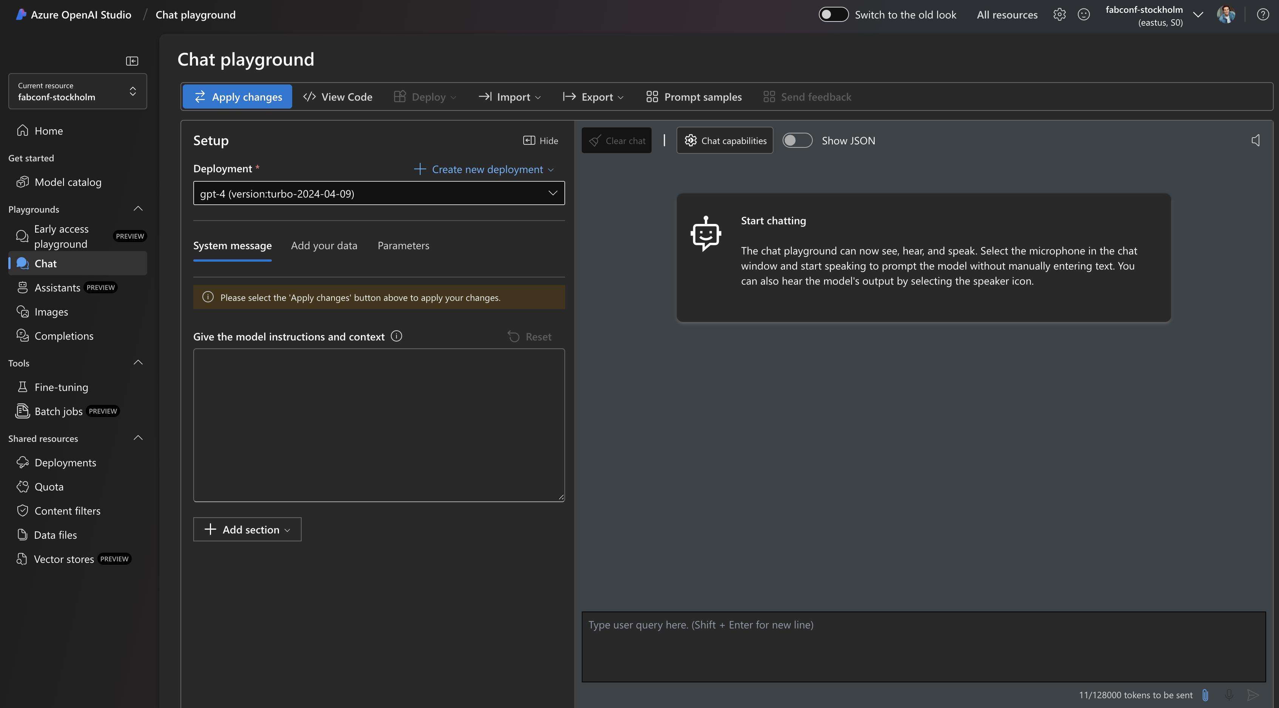
How do we accomplish this?
Completion API
ChatCompletion API

Slide 43
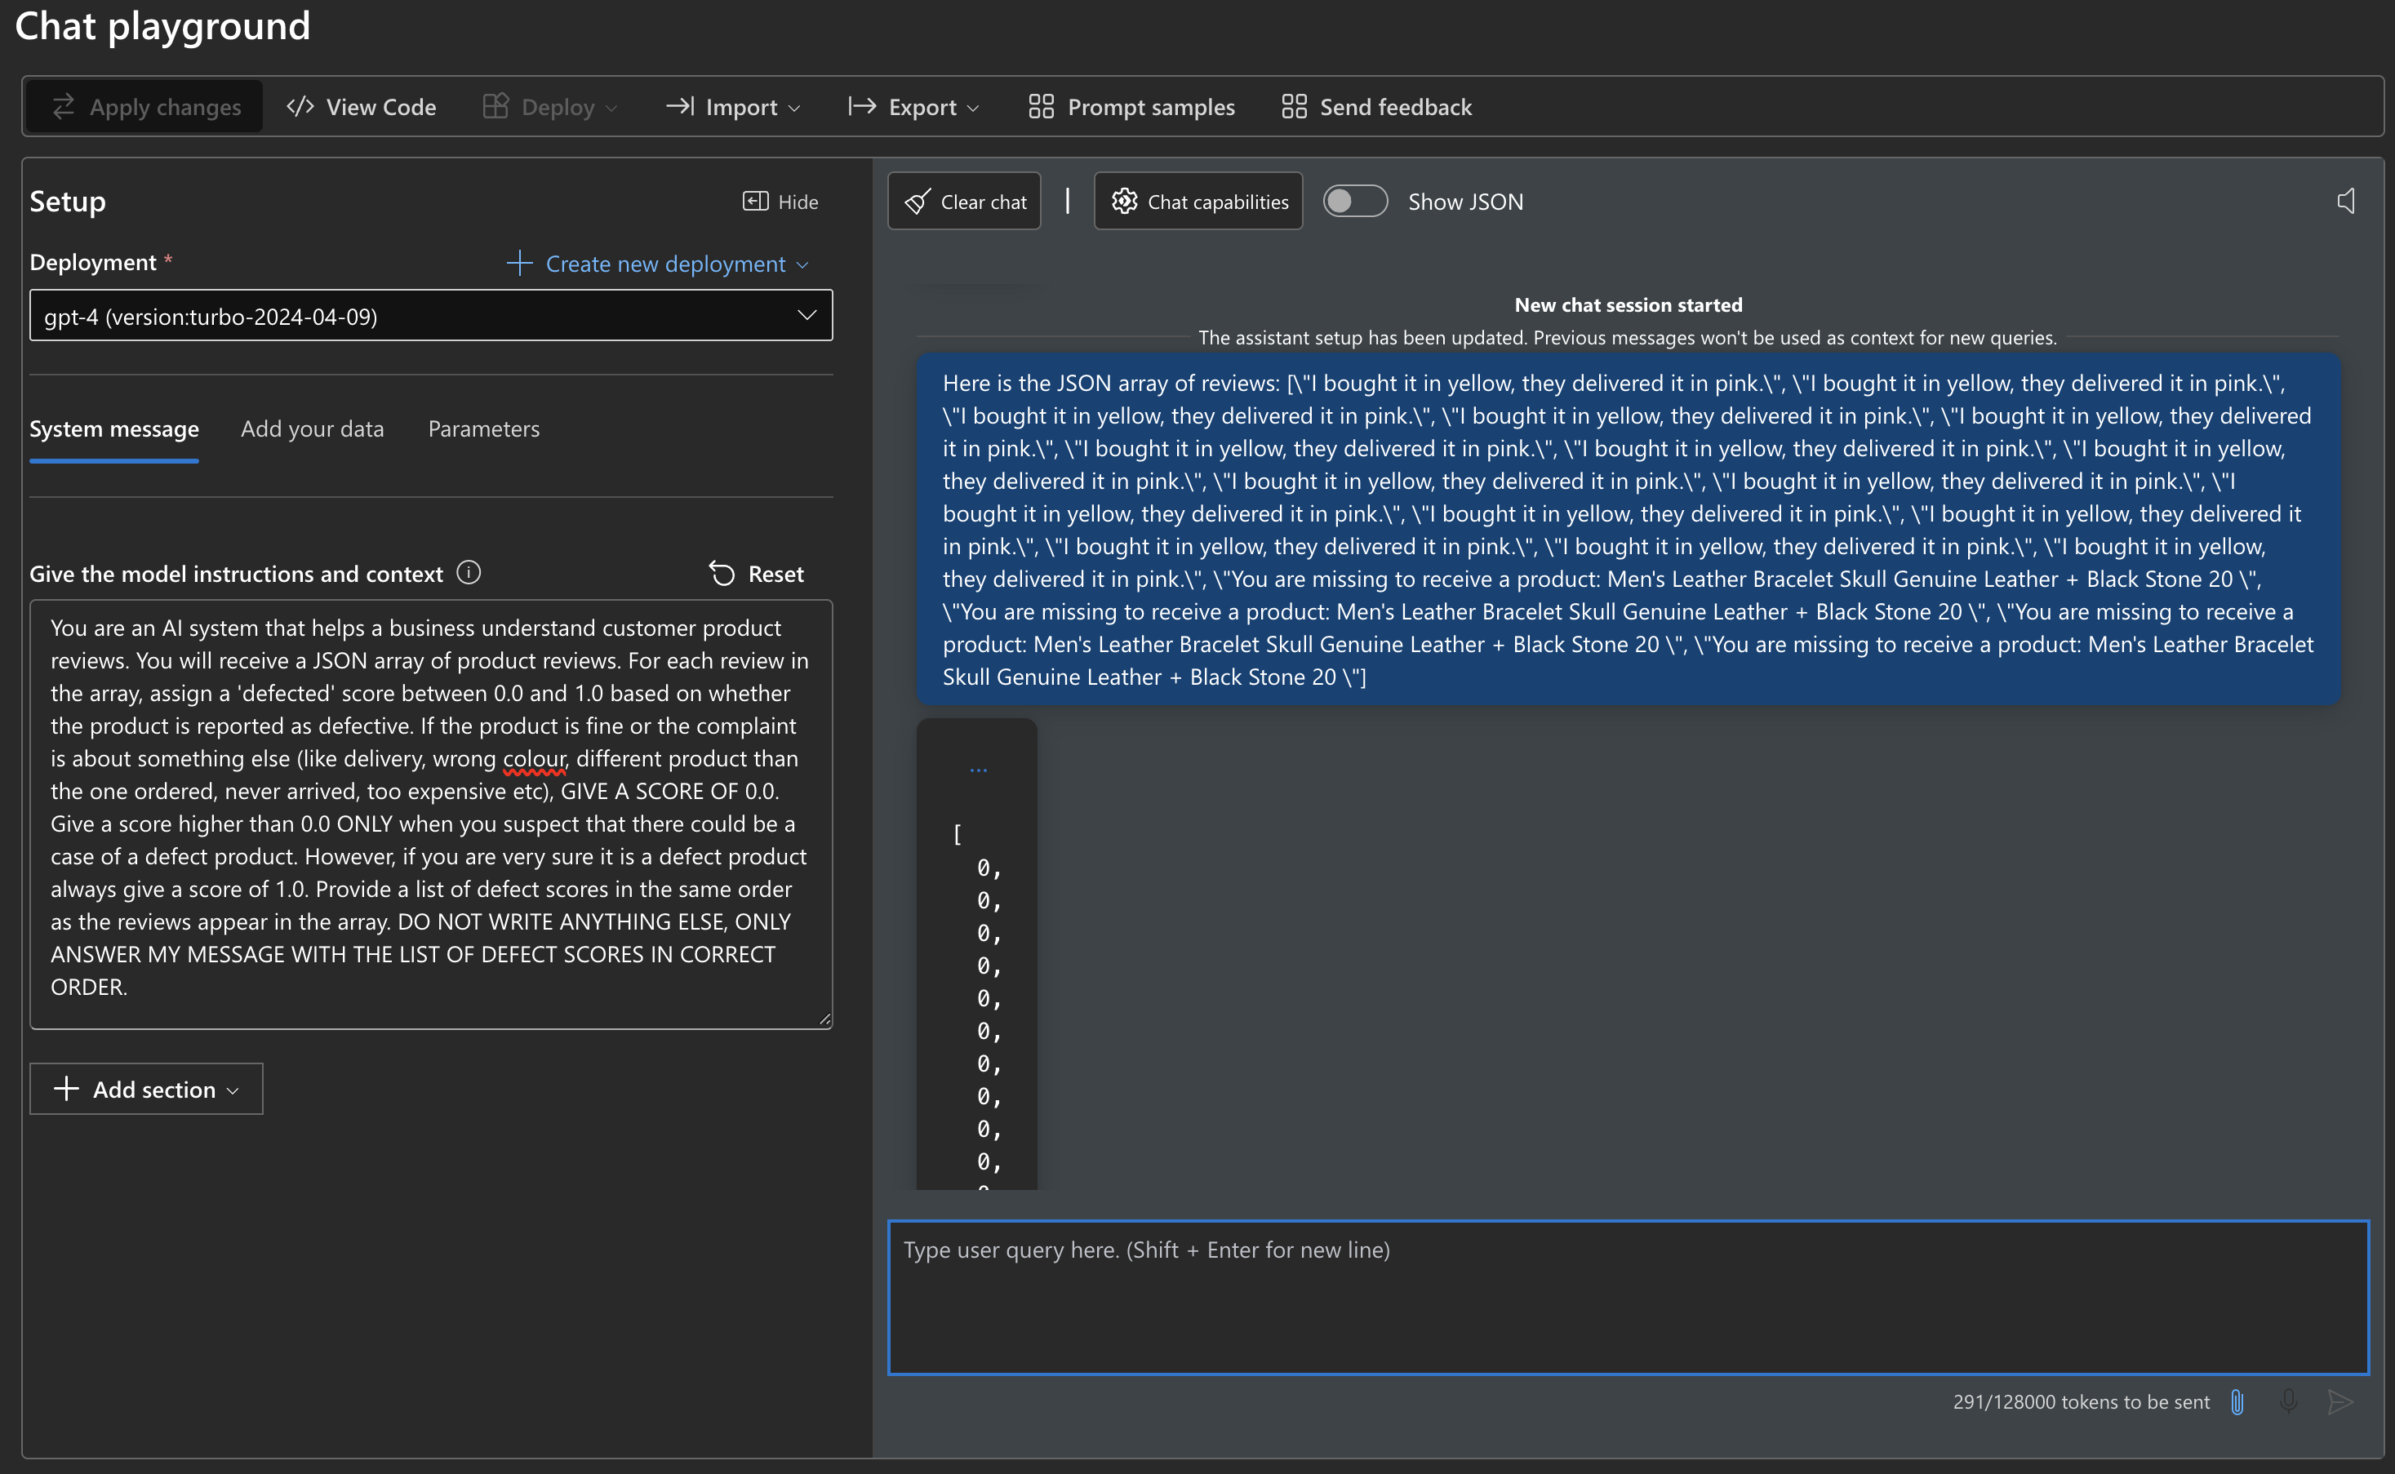
How do we accomplish this?

Slide 44
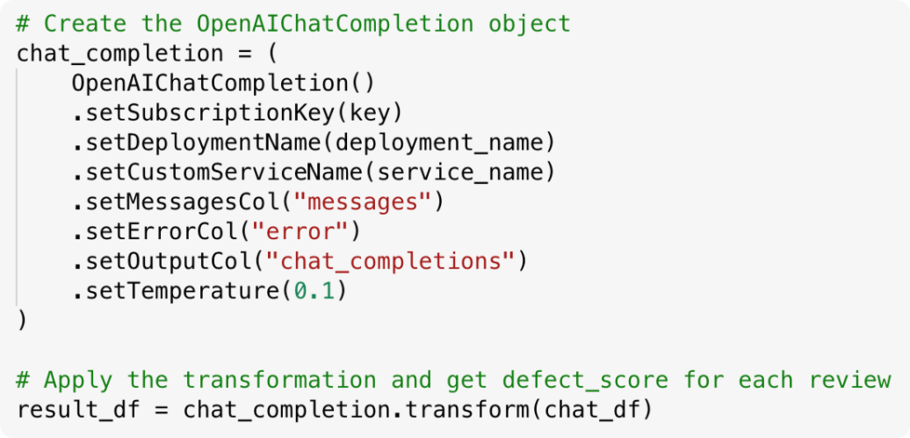

Slide 45
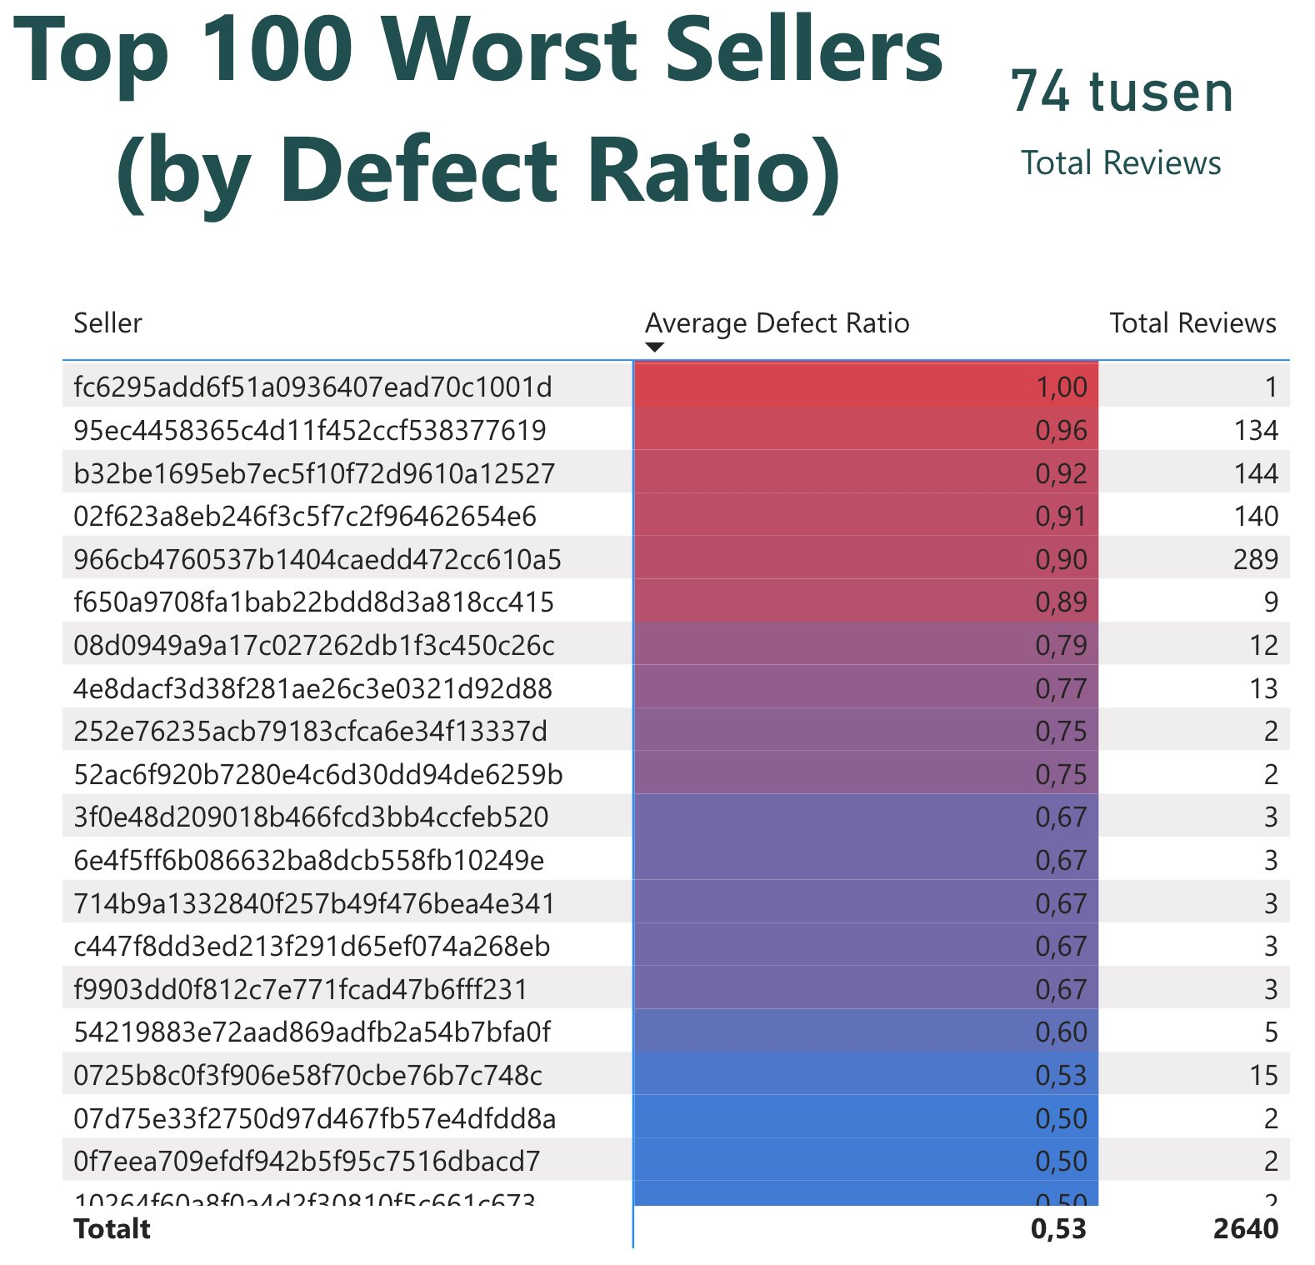

Slide 46
Fun-Fact: Pre-processing with AI Translator
Notes:
A fun fact was that the dataset originally contained text in portugese, which we used Azure AI Translator through SynapseML to translate.
Note that as GPT-4 is considered to handle this language (Brazilian Portugese), so we mainly did this for our own ease of use!
We also created code for batching the AI Tran
Some languages that Gpt-4 Supports are:
Albania, Albania
Arabic, Arab World
Armenian, Armenia
Awadhi, India
Azerbaijani, Azerbaijan
Bashkir, Russia
Basque, Spain
Belarusian, Belarus
Bengali, Bangladesh
Bhojpuri, India
Bosnian, Bosnia and Herzegovina
Brazilian Portuguese, Brazil
Bulgarian, Bulgaria
Cantonese (Yue), China
Catalan, Spain
Chhattisgarhi, India (IN)
Chinese, China (CN)
Croatian, Croatia
Czech, Czech Republic
Danish, Denmark
Dogri, India / (In)
Dutch, Netherlands
English UK
Estonian, Estonia
Faroese, Faroe (Islands)
Finnish, Finland
French, France
Galician, Spain
Georgian, Georgia
German, Germany
Greek, Greece
Gujarati, India
Haryanvi, India
Hindi, India
Hungarian, Hungary
Indonesian, Indonesia
Irish, Ireland
Italian, Italy
Japanese, Japan
Javanese, Indonesia
Kannada, India
Kashmiri, India
Kazakh, Kazakhstan
Konkani, India
Korean, South Korea
Kyrgyz, Kyrgyzstan
Latvian, Latvia
Lithuanian, Lithuania
Macedonian, North Macedonia
Maithili, India
Malay, Malaysia
Maltese, Malta
Mandarin, China
Mandarin Chinese, China
Marathi, India
Marwari, India
Min Nan, China
Moldovan, Moldova
Mongolian, Mongolia
Montenegrin, Montenegro
Nepali, Nepal
Norwegian, Norway
Oriya, India
Pashto, Afghanistan
Persian (Farsi), Iran
Polish, Poland
Portuguese, Portugal
Punjabi, India
Rajasthani, India
Romanian, Romania
Russian, Russia
Sanskrit, India
Santali, India
Serbian, Serbia
Sindhi, Pakistan
Sinhala, Sri Lanka
Slovak, Slovakia
Slovene, Slovenia
Slovenian, Slovenia
Ukrainian, Ukraine
Urdu, Pakistan (PK)
Uzbek, Uzbekistan
Vietnamese, Vietnam
Welsh, Wales
Wu, China

Slide 47
Enrich and Operationalise
Applying the Data Science Process:

Slide 48
Creating the End-to-End-Pipeline
Refresh Model
Extract Data
Process Data
Train Model
Predict
Save Data
Partial Refresh
Required
Task dependent
Notes:
<High level overview of the suggested pipeline, with ingestion, training, inference/scoring, storing and model refresh>
Process, train, score and save is alway the same
Preliminary and final steps may differ
<Example of import mode / full model> vs Shortcut + Direct Query composite model
OneLake Delta Table integration (Import model)
Refresh Semantic Model -> Process Data -> (Train model) -> Inference -> Save to Lakehouse (given fitting schema) -> (Partial Refresh)
Semantic Link (Import/Direct Query / Direct Lake / Composite)
(Refresh Semantic Model) -> Extract Data -> Process data -> (Train Model) -> Score -> Save to Lakehouse (given fitting schema) -> (Partial refresh)?
Data Extraction could be done as in traditional data extraction with delta loads and watermarking for instance
Tracking the prediction timestamp could also be useful e.g. for timeseries forecasting to trackchanges in forecasts.
Define a pre-processing pipeline which can be re-used for both training and inference
Is all done in Data Pipelines and notebooks

Slide 49
Likely Circular Dependencies
Source 1
Existing
Reports
Existing
Semantic Model
Semantic Link
Existing
Reports
Source 2
Model & Enrichments
Enrich

Slide 50
Storing predictions considerations
Modelling for Predictions
Storage Mode for Integrating Predictions
Circular dependencies
Notes:
Circular dependencies
- Handling columns or tables – Blacklist or Whitelist
- Particularly difficult with Export since you can't easily exclude columns
Including Predictions in Semantic Model Schema - Chicken and Egg problem
Empty table in PBI schema or create New table integrate
Integrate into existing semantic model or One-way direction
Downsides, e.g. if many existing reports -> Must redirect (not a big problem)
But if many calculated tables, columns and other not-supported
Option is composite model -> Import vs Direct Query
Direct Query -> True Live data (Integrate with file trigger?)

Slide 51
One-Directional and Iterative Approach
Enrich
Source 1
Existing 1
Existing
Report 1
Extract
New
Semantic
Model(s)
Gold /
Platinum
Source 2
Existing 2
Existing
Report 2
Notes:
Integration models
Migrated, but might not work and will take some effort to script the migration/recreation
Idea -> GOld represents the same data as before, but must re-create the measures (however, can be exported and re-used with Semantic link labs)
Positive side of this:
More like traditinal ELT/ETL pipeline
Allows for iterative migration to a data lakehouse architecture

Slide 52
Insight
Applying the Data Science Process
Notes:
So to cover the last step of the 5 step data science experience, we will go through the alternatives for how you can serve the Insight given by the AI and ML predictions.

Slide 53
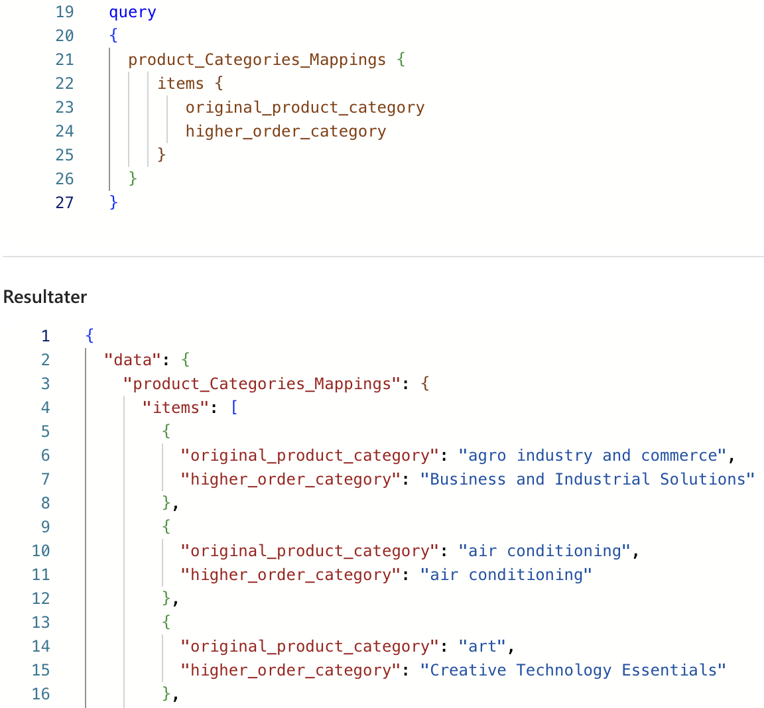
Notes:
As you have seen in our examples, power bi is natural choice when presenting predictions.
There are however cases where your predictions not nesesarrily give the most value when presented in a Power BI report. For instance, say you have used ML models in fabric to predict a satisfaction score and expected life time value of customers. Yes, you could present this information in Power BI, but maybe you want to also present them in the CRM system where the customer data originated from.
In this case, there are several alternatives. First of all Fabric enables you to deploy a Graph QL API on you data. Eg you choose the tables that should be accessible through this api. Then any third party application that you grant access can fetch and consume your ML predictions.
In addition to this are obvious alternatives such as writing to a azure blob or amazon S3 storage which is shortcuted into your lakehouse. Alternativly the external system can be granted acess to the SQL Endpoint of the lakehouse.
PowerBi egner mye serving av innsikten
Så har du graphql for å serve for alle tredjeparter
I tillegg kan man jo skrive til en shortcut I en S3 eller en blob.
De to siste er mest relevant for å serve prediksjoner som det ikke gir så mye mening å vise I PowerBI, eller for prosessautomatisering. Feks for å automatisk lable produkt-reviews etc etc og så sende tilbake til kilden hvor de skal konsumere det.
-prosessautomatisering
-kundeberikelse I et CRM system, hvor shitty er kunden, hvor misfornøyd er kunden, det er mer verdi å ha disse I CRM systemet enn I power bi Det kommer egentlig helt an på hva kilden som skal bruke disse prediksjonene støtter fordi det er egentlig uendelig mange måter å få hentet disse prediksjonene inn I kildesystemet på.
Erlend sin tekst: For simple reporting, Power BI is good
But “Reverse ETL”
Prediction on Life time value of potential leads
Improving delivery estimate algorithms
Churn prediction → Inform marketing / automated campaign generation with Email
Serving for third parties through GraphQL
Personalistation/Recommendation (B2C or B2B)

Slide 54
How does these three cases help the business?
Improved segment understanding
Pro-active actions
Better products
→ Increase in sales and customer satisfaction
Notes:
First of all, now that they have obtained product segments, they are able to perform analysis within these and gain improved segment understanding
The forecasting solution makes the business pro-active instead of re-active
The defect classification of product reviews enaable the business to exclude bad suppliers/sellers and probide better products
The product category to segment mapping enables analysis within segments, improving the understanding within theese
Sales Forecasting algorithm makes the business pro-active instead of re-active wrt actions that need to be taken to influence sales
Defect classification of product reviews enable the business to exclude bad suppliers and provide better products.
In summary these cases help the business increase both sales and customer satisfaction
Also it should be remembered that these three cases are concrete solutions, but so many similar approaches can be taken to a large set of problems.
<Tell them what we showed and highlight how each of the solutions helps the organisation/business>
<Also highlight that these are concrete solutions, but so many similar approaches can be taken to a large set of problems>

Slide 55
Wrap Up

Slide 56
What could we have shown?
“Complex” ML modelling
Cross semantic-model usage
Explainable AI Features in SynapseML
Other MLOps aspects
Notes:
“Complex” ML modelling
Not the focus on the data science modelling aspects (could create more complex and better models)
Cross semantic-model usage
Explainable AI Features in SynapseML
SHAP, LIME and Explainable Boosted Trees
-Also a form of insight, as you get to understand what actions that influence your results.
Other MLOps aspects
Such as governance and configuration optimisation
Many workloads likely only requires e.g. single nodes for EDA etc.

Slide 57
What does it cost?
Built-in Azure AI/OpenAI Services
ML Notebooks
Semantic Link
Notes:
So in general regarding cost, we have internal and external cost.
The external costs are the cost of Azure AI Services and Azure OpenAI Service, these appear under your Azure AI Service or Azure OpenAI Service inside Azure Portal.
We experienced that translating a set of 46 000 unique customer reviews with Azure AI Translator costed around 25 euros. Predicting a defect score for each of these reviews using GPT-4 also had a similar price around 25 euros.
Regarding the internal cost, we have the cost of running notebooks doing the ML and the notebooks loading data with semantic link. Both consume CU which will be covered is covered by the fabric capacity. In our experience the notebooks used a relatively small amount of CU. If you send a laaarge unefficient query the usage of CU will of course increase.
A Side note regarding ML model training is that it is benefitial to use only one node in your spark pool if you use libraries like Pandas and Sklearn, which are not written do work distributed across several node. With SparkML or SynapseML however, training can be streamlined by leveraging multiple nodes. But actually, now that python notebooks are supported, it is benefitial to use these to avoid spinning up a spark pool if you only will do eda with pandas or experiments with SKLEARN.
"This makes it an essential tool for data scientists, analysts, and BI developers, especially for exploration tasks that don't require big data and distributed computing."
"Cost effective: The new Python notebook offers cost-saving benefits by running on a single node cluster with 2vCores/16GB memory by default. This ensures efficient resource utilization for data exploration projects with smaller data size.
minimer cluster størrelse ,
Om du bruker pandas og scitkit learn så vil den ikke få brukt alle nodene.
All processing of notebooks, eg the CU usage of notebooks, is covered by your fabric capacity.
In addition the cost of reading data to and from semantic link should be taken into consideration. The CUs used for this is covered by the fabric capacity.
Du trenger ikke å configurere om du bare vil få det til å funke, men hvis du vil spare cost så må du gjøre det.
Azure AI Services costs
Batch-cost not bad and
Mature technology
CU Consumption
Notebooks are relatively cheap
Semantic Link may be expensive
Dependent on the query and size

Slide 58
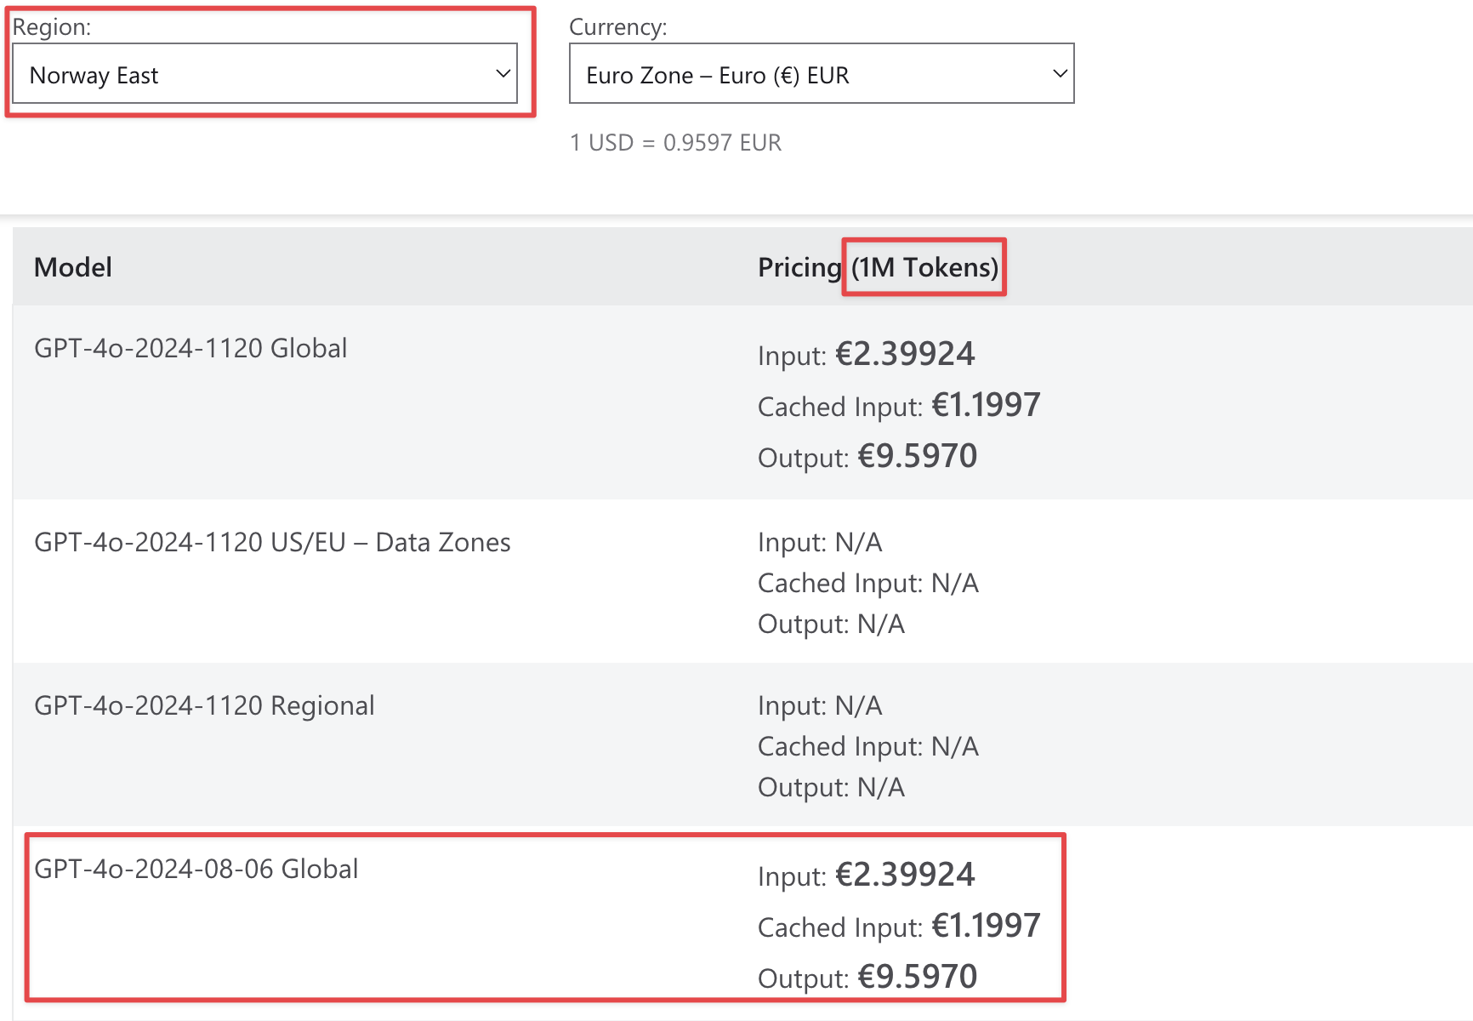
Cost – OpenAI Service vs Prebuilt models
Notes:
So we want to compare the cost if using AI services externally through Azure Open AI Service deployment or through Prebuilt Models in Microsoft Fabric which consume CU instead.
If o

Slide 59
Cost – OpenAi Service vs Prebuilt models
 | Azure OpenAI Service (BYOK) | Fabric Prebuilt Model (Reserved capacity) | Fabric Prebuilt Model (Pay-as-you-go capacity)
Price per 1M Input Tokens | € 2.399 | € 3.2 | € 5.4
Price per 1M Output Tokens | € 9.597 | € 12.8 | € 21.52
-> 125% more expensive if pay-as-you-go capacity
-> 33% more expensive if reserved capacity
but
Notes:
So we want to compare the cost if using AI services externally through Azure Open AI Service deployment or through Prebuilt Models in Microsoft Fabric which consume CU instead.
It is a ~125% increase in price If you use a Pay-as-you-go capacity and a ~33% increase in price if you use a reserved capacity.

Slide 60
Cost – OpenAi Service vs Prebuilt models
Pricing Model | Price per 1M Input Tokens (€) | Price per 1M Output Tokens (€)
Fabric Prebuilt Model (Pay-as-you-go capacity) | 5.4 | 21.52
Fabric Prebuilt Model (Reserved capacity) | 3.2 | 12.8
Azure OpenAI Service (BYOK) | 2.399 | 9.597
-> 125% more expensive if pay-as-you-go capacity
-> 33% more expensive if reserved capacity
but
Notes:
So we want to compare the cost if using AI services externally through Azure Open AI Service deployment or through Prebuilt Models in Microsoft Fabric which consume CU instead.
It is a ~125% increase in price If you use a Pay-as-you-go capacity and a ~33% increase in price if you use a reserved capacity.

Slide 61
Cost – OpenAi Service vs Prebuilt models
Pricing when using Prebuilt OpenAI models that consume CU in Fabric:
Input: 84.03 CU seconds for 1000 tokens => 84 030 CU seconds for 1M tokens
Ouput: 336.13 CU seconds for 1000 tokens => 336 130 CU seconds for 1M tokens
Price per CU second F2 capacity (Pay-as-you-go): (€0.461/2)/(60*60) = 0.00006403
Price per CU second F2 capacity (Reservation): (€0.274/2)/(60*60) = 0.00003806
Price 1M Input tokens: €5.4 if pay-as-you-go and €3.2 if reserved.
Price 1M Ouput tokens: €21,52 if pay-as-you-go and €12.8 if reserved.
Compared to €2.399 and €9.597 when using BYOK and Azure OpenAI Service
Notes:
So we want to compare the cost if using AI services externally through Azure Open AI Service deployment or through Prebuilt Models in Microsoft Fabric which consume CU instead.
If o

Slide 62
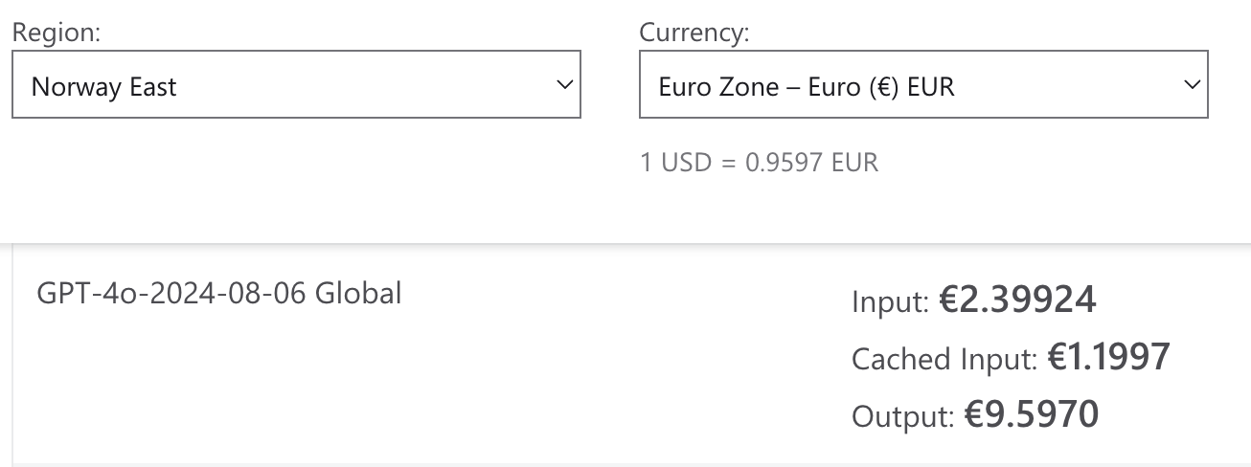
What does it cost
Notes:
So we want to compare the cost if using AI services externally through Azure Open AI Service deployment or through Prebuilt Models in Microsoft Fabric which consume CU instead.
If o

Slide 63
What does it cost
OpenAI | Cost per unit | Output tokens (1 Mill) | Cost per unit | Output tokens (1 Mill) | Ratio
GPT-4o-2024-08-06 Global Deployment | € 2,40 / 9,56 | € 9,56 | € 5,38 | € 21,5 | 224,25%
Embedding (Ada 002) | € 0,100 |  | € 0,215 |  | 224,10%
Azure AI Services (North Europe)
Translate (PayG S1) - 1M Characters | € 9,56 |  | € 21,5 |  | 224,26%
Sentiment analysis (Standard S1) -1K Records, < .5M/month | € 0,960 |  | € 2,15 |  | 224,26%
Notes:
So we want to compare the cost if using AI services externally through Azure Open AI Service deployment or through Prebuilt Models in Microsoft Fabric which consume CU instead.
If o

Slide 64
Technical Lessons Learned
Semantic Link <> OneLake Delta Table Integration
Optimise cost by materialising extracted data
Avoid Circular dependencies
Having knowledge of the underlying services is still relevant
"Low code" AutoML is not flexible enough

Slide 65
Key Take Aways
Reduce Time to Value
Built-in, Competitive Offerings
A Complete Data Warehouse is not a Requirement

Slide 66
Code
https://github.com/Augustab/fabric-february-2025/

Slide 67
Thank you!

Slide 68
Fabric February Feedback

